Slide 1

Муниципальное образовательное учреждение
Дополнительного образования
«Центр внешкольной работы «Юность»
г.Комсомольск-на-Амуре
2018г.
Present Perfect
Автор: Анисимова Вера Константиновна,
Педагог дополнительного образования

Slide 2
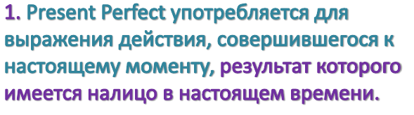
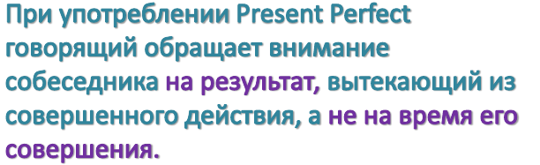

Slide 3
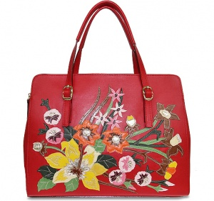

I have bought a new bag.
He has lost his keys.
We have met friends.
I have finished decorating my room.

Slide 4
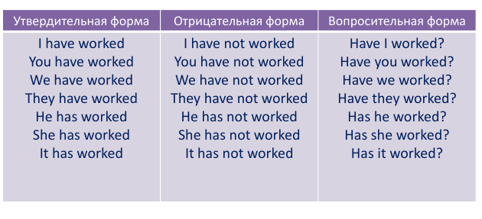

Slide 5
Complete. Use the Present Perfect
You ……….. all the cake! (eat)
Mark ……… Jenny to his party. (invite)
Mum and dad ……… Kate’s letter. (not read)
Dina ………. her homework. (not finish)
They ………. (leave)

Slide 6
6. I ……….. that boy’s name. (forget)
7. The rain ……… . (not stop)
8. We the children’s presents in the cupboard……… . (hide)
9. You ……….your room! (not tidy)
10. I………. lunch. (not have)

Slide 8
Circle the correct answer
Where’s John?
He’s gone/been to the shops to buy some milk.
2. Have you ever gone/been to the USA?
Not, but I really want to go.
3. We’ve gone/been to Paris lots of times.
It’s a beautiful city, isn’t it?
4. Carl has gone/been to bed.
What? Already? It’s only nine o’clock.

Slide 9
5. Where has everybody gone/been?
To the cinema. They’ll back at half past seven.
6. We haven’t gone/been to the new sports centre.
Let’s go tomorrow, then.
7. Are the boys in the garden?
No. They’ve gone/been to the park.
8. Have you gone/been to the opera?
No, I haven’t. What about you?

Slide 10
already | уже | I have already watched TV.
just | только что | I have just watched TV.
yet (в отрицат. и в вопросит. предложениях) | ещё не | He has not read a book yet. Has Samantha phoned yet?
for | В течение, на протяжении | I haven’t seen Tom for three days.
since | С (какого времени, момента) | I have worked there since 2008.
ппрр

Slide 11
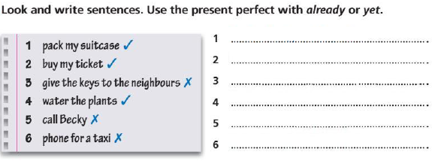
She has already packed her suitcase.

Slide 12
Вставьте since или for.
Meredith has lived here _________ 1997.
Meredith has lived here ______ eighteen years.
John has had the ball_________ last July.
He has had the ball _________ eight months.
Molly has liked fairy-tales _________ she was a tiny baby.
Steven has been a worker_________ he left school.

Slide 13
7. We have had three tests _________ Tuesday.
8. The couple have stayed here _____ three days.
9. I have had my player _________ ten weeks.
10.Molly has had the player_________ Christmas.
11. They’ve lived in that house_______ 2007.
12. My mum has been a teacher______ sixteen years.
13. He has forgotten his Spanish ______ he left Cuba.
14. They haven’t bought any vegetables at the market ______3 years.

Slide 14
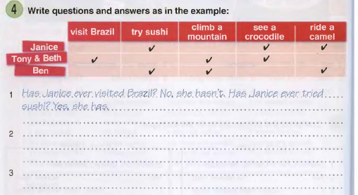

Slide 15
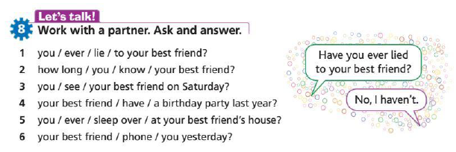

Slide 17
Список использованных интернет-ресурсов:
http://www.sumki-elbi.ru/images/catalog/catalog/8800_image_small.jpeg
https://reiki-lotos.ucoz.ru/_fr/31/5399040.jpg
Список использованной литературы:
1. Virginia Evans, Jenny Dooley «New Round Up 3. Student’s book» // Pearson Education Limited, Edinburg, 2010г.
2. Jenny Dooley, Virginia Evans «Grammarway 2» //Практическое пособие по грамматике английского языка. – М., 2003г.
3. Zandra Daniels, Lee Coveney «Grammar genius 2»//Hamilton House, Publisher Ltd, Cyprus, 2012г.

